Slide 1
Underpinning knowledge
Mix of livestream, directed study and F2F, rotation of learners
Option 1, All learners remote classes via BBB
Option 2, learners present and remote classes simultaneously
Option 3, Mix of both options
Workshops/practical work
Recording demos
Prior, during and post workshops
Casting to avoid learners clustering

Slide 2
Technology
Teacher
Headset
Digitising tablet
Second screen
Classroom
Wide-angle camera
Close up camera
Microphone
Multiple screens
Workshop
Camera
Headcam
Lighting
Tripod

Slide 3


Option 2: Duel delivery
BBB +whiteboard

Slide 4
College day/block
Teacher
Attending learner
Remote learner
9.00
Classroom
Teaching
Classroom
Time
Directed study
Livestream lesson
Livestream lesson
Livestream lesson
Practical/workshop
Practical/workshop
Directed study
Support and feedback
Directed study

Slide 5
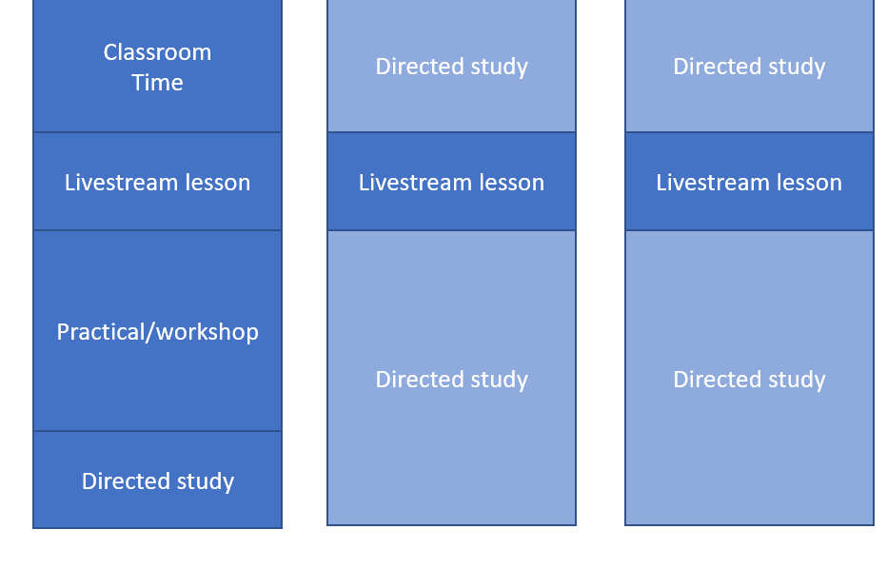
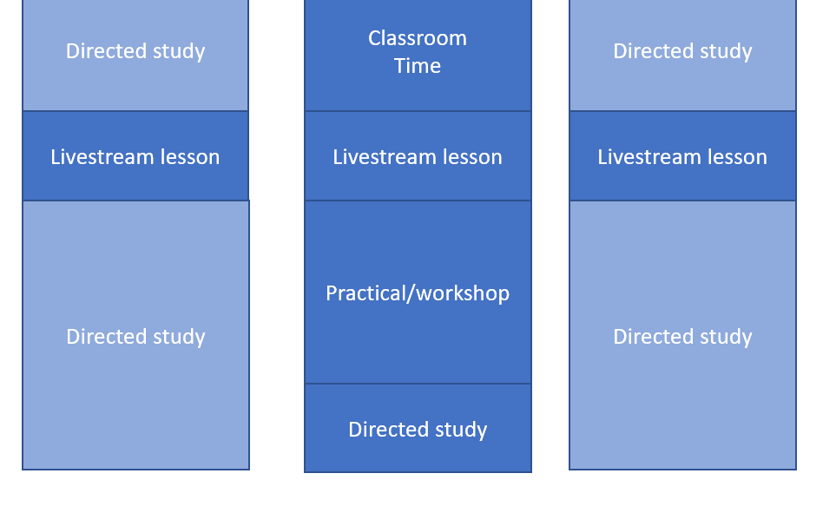
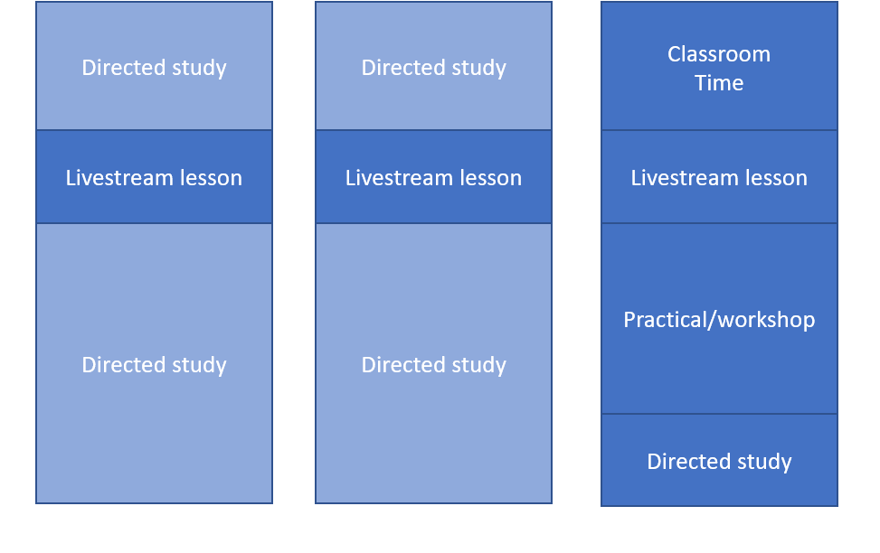
Rotation
models
Group 1
Group 2
Group 3
Day/block 1
“7”
Day /block 2
Day /block 3

Slide 6
Pedagogy
ALN | Enriched Virtual + Individual Rotation structure
ILS, Traineeship L1 | Enriched Virtual + Station Rotation structure
L2, L3 yr1 | Enriched Virtual + Station Rotation structure
L3 yr2, A Levels | Enriched Virtual + Station Rotation structure + Flipped Classroom
HE | Enriched Virtual + Flipped Classroom + Flex
https://www.blendedlearning.org/models/#lab

Slide 7
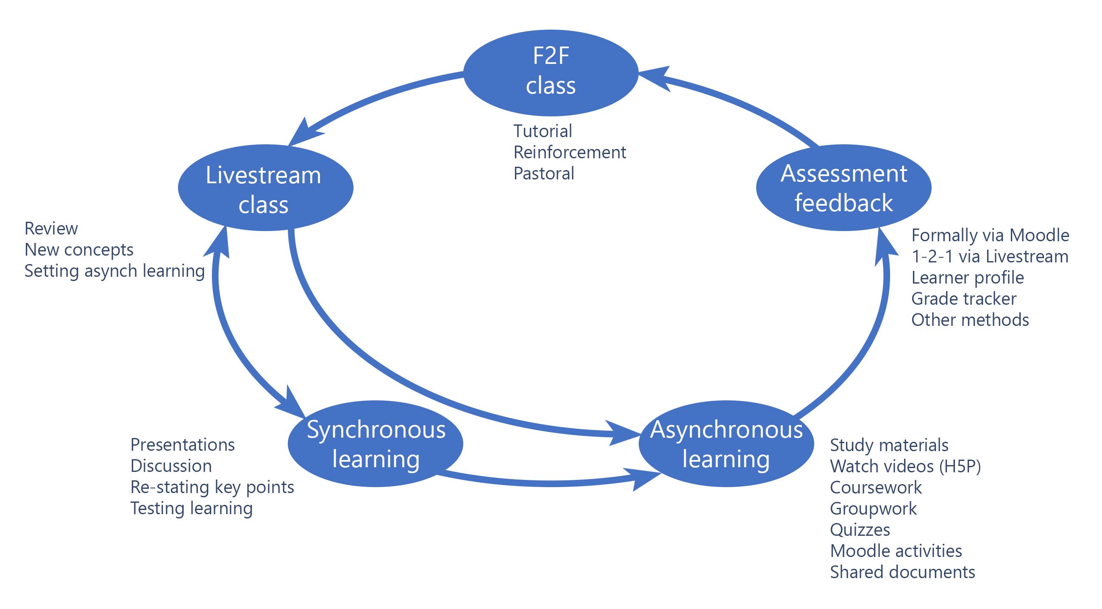

Slide 8
Training
Synchronous technology
Asynchronous technology
Classroom technology
Workshop technology
Basic IT!
Pedagogy

Slide 9
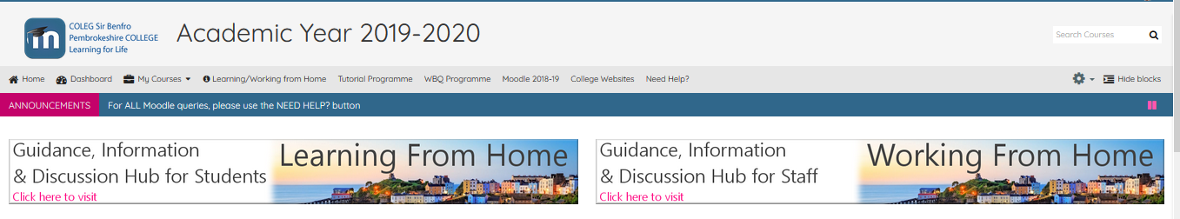
Support
Redeployment of the directed study team
Joint team set up combining technical and pedagogy experts
New physical space created
Setup with the technology
Online support desk ticketing system

Slide 10
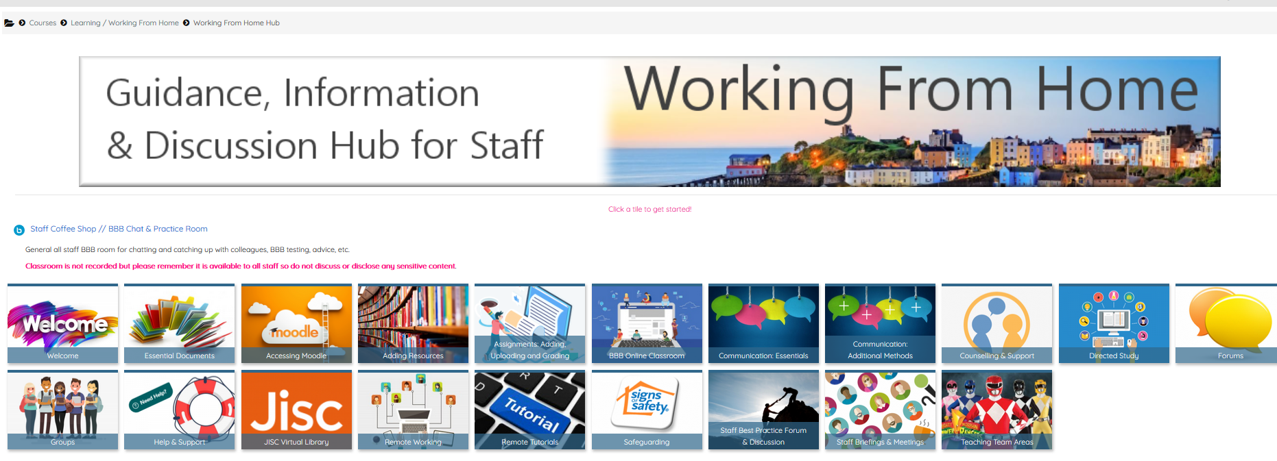

Slide 11
Challenges
Engagement
Staff skills

